Slide 1
Single station data preparation for Seismic Ambient Noise Tomography
A new method of normalization introduced by me
Akash Kharita
17411002

Slide 2

Suppose you are a seismologist/working in an oil exploration company.
Your boss said we do not have enough budget to perform active seismic study/Vibroseis truck will damage the ground.
You said ok, no problem we will use passive seismic data to image the subsurface.
But you live very far away from the earthquake prone areas and never experienced any earthquake, Now what will you do?

Slide 3
What if I tell you there exists a technique which don’t require any source and can produce a high resolution image of subsurface upto 30 Km?
Seismic ambient noise tomography is a technique based on the principle that the correlation of random noise recorded at two stations produces a green’s function of surface waves between them.
The first use of this technique was to extract high resolution crustal images of Central California.(Shapiro et al. 2005) using 62 seismic stations deployed as a part of USarray program

Slide 4
If an event occurred near B is recorded at A, the derived green function is observed to look exactly similar to that obtained by cross correlating the noise
Noise recorded at station A is assumed to come uniformly from all the small scale source along the circle , similarly for B.
When we correlate the noise, it is observed to produce a green’s function of the surface wave , which is the impulse response of the crust between station A and B
Station A
Station B

Slide 5
Seismic Ambient Noise Tomography (ANT)
It involves 3 steps
Data acquisition
Data processing
Data interpretation
Deployment of dense array of seismometers, more the seismometers better will be the resolution we will have.
Acquiring the recorded data, and store them in our computer, acquired files may be in mseed /sac format
3) Various datacentres around the world eg. fdsn,gsn etc provides free access to seismic data , we can also download data from isc .
Data of all the pairs of station in a given network is cross correlated to find the estimated green function of the rayleigh waves, cross correlations at different lags are then stacked and ploted
Before cross correlation, data of individual station needs to be filtered(in this case I filtered it from 5 to 10s), detrended, whitened and Normalized.
Green functions are estimated between all the possible station pairs in a network
Dispersion curves are estimated using green’s functions by FTAN (Dziewonski et al,,1969)
3) Dispersion curves are then inverted to give the values of P and S velocities.

Slide 6
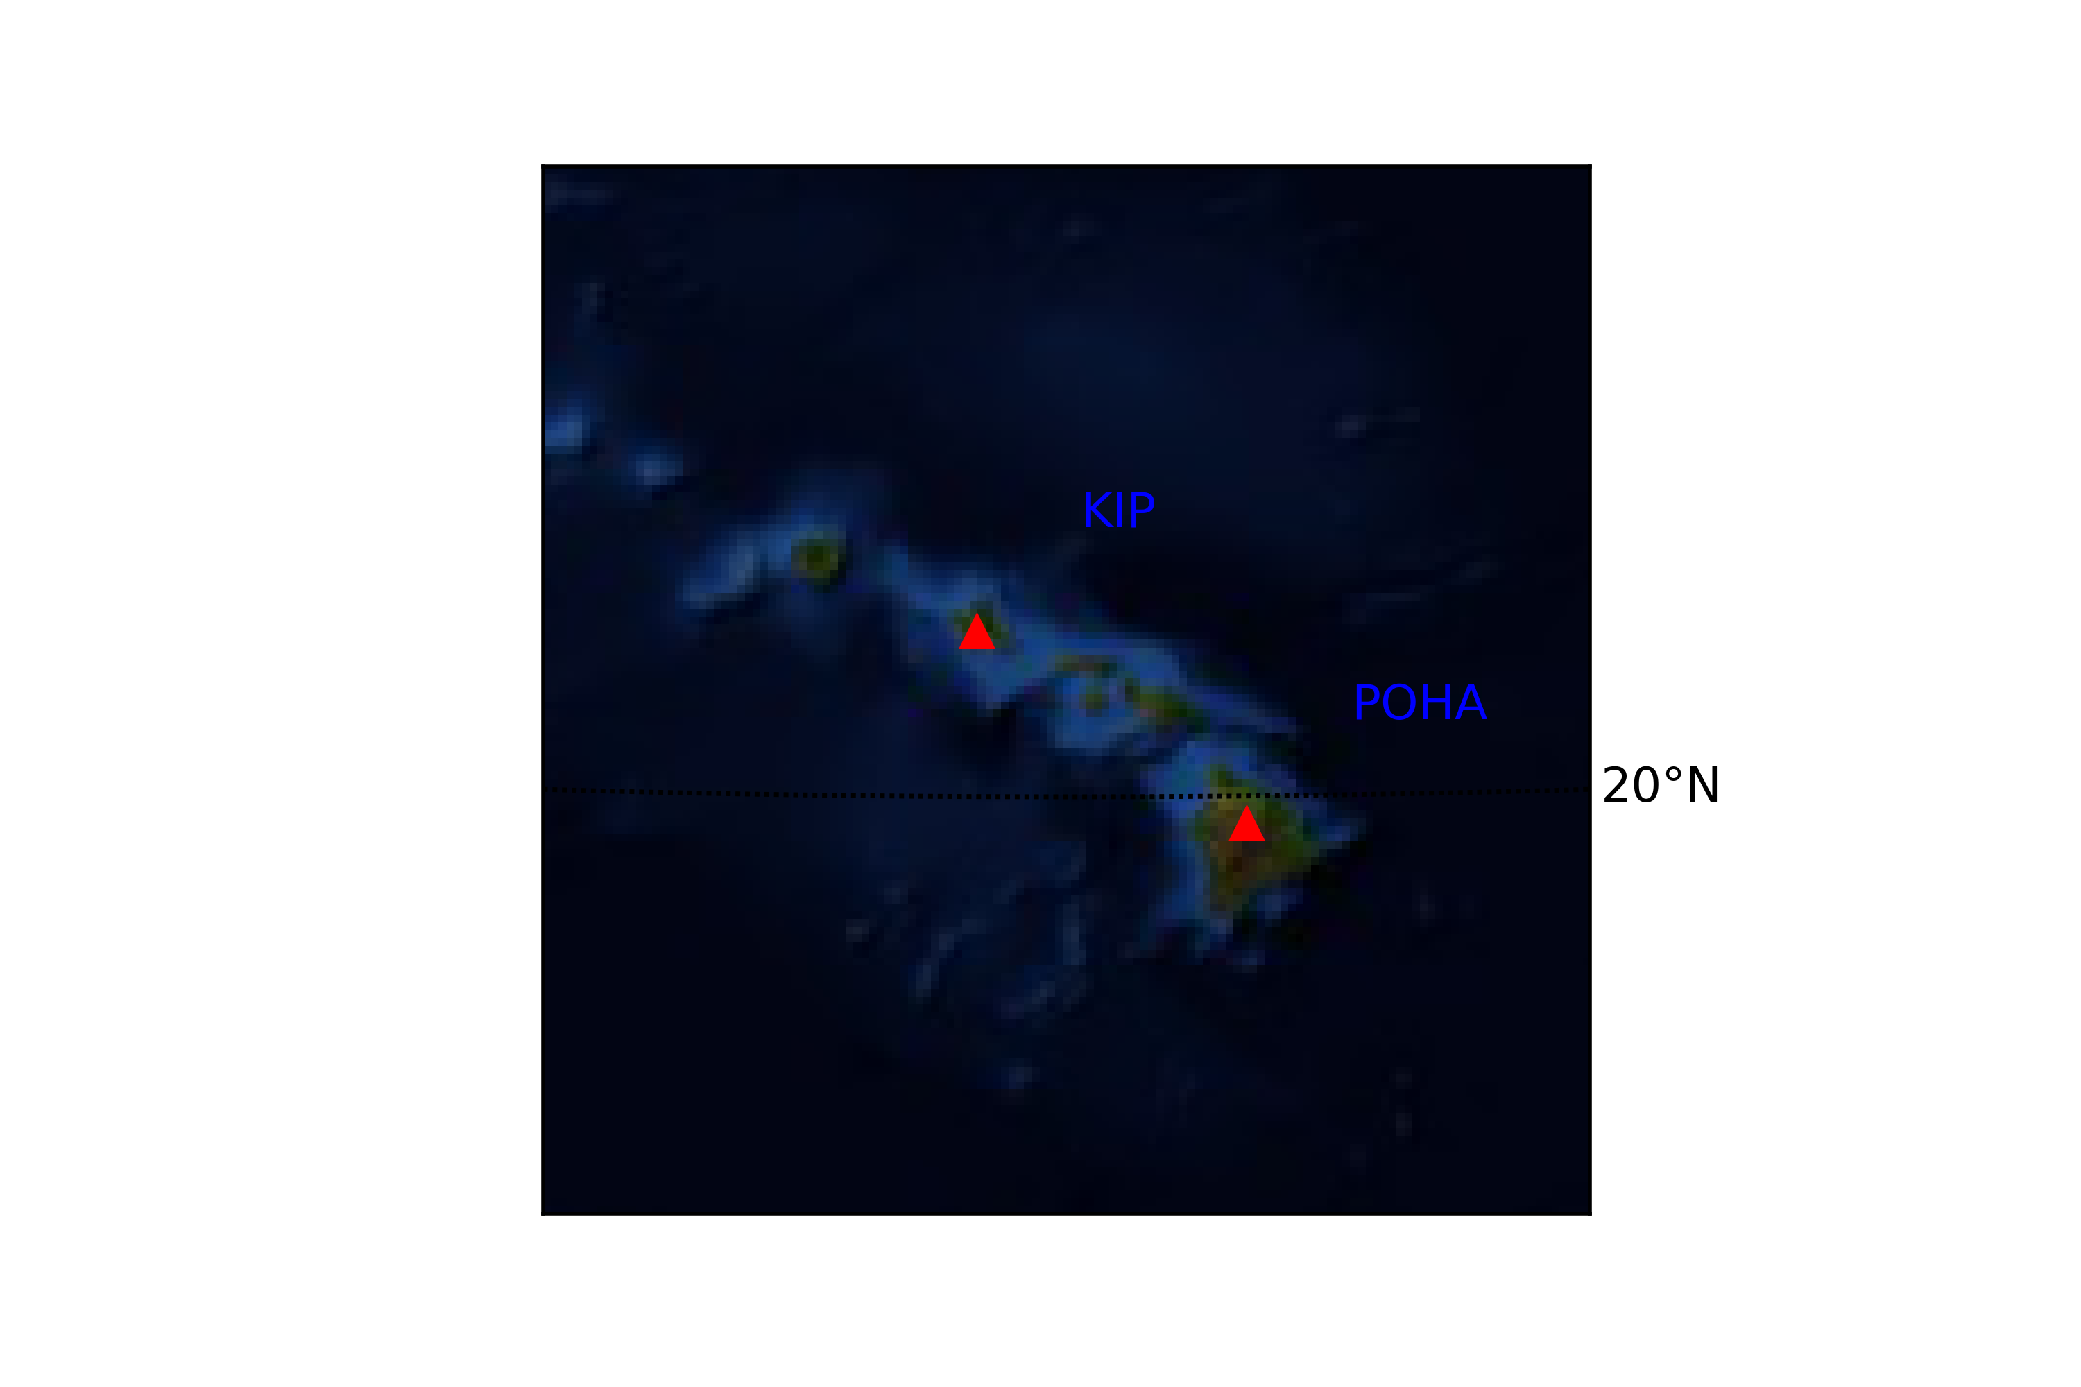
I did 1st and 2nd steps
Data acquisition : vertical component continuous time series data of two months (01/01/2015-28/02/2015) was acquired from two long period seismic stations “KIP” and “POHA” in Hawaii by requesting from GSN (global seismograph networks) in the mseed format.
Map showing “KIP” and “POHA’ seismic stations of Hawaii, created using GMT

Slide 7
2nd Step : Data processing
(i)Raw data of both station is first detrended, tapered at the edges, and filtered using bandpass filtered using band of 0.1 to 0.2
(ii)Data is then normalized using one from several methods defined. Normalization does two things – 1) It will try to reduce the effect of small/large earthquakes in our data so we can have a total random noise justifying our assumption .
2) It will improve signal to noise ratio
(iii)Normalized data is then whitened (making the amplitudes of all frequencies in the band uniform) whitening is done by first taking the fourier transform of the data and multiplying the amplitude spectrum by a Hanning window
(iv) Now data of both stations are correlated using a time window of a given length. Each correlations are then stacked vertically and summed. These sum is plotted to give noise correlation between two stations.
Bensen et al. 2007: Processing ambient seismic noise data to obtain reliable broadband surface wave dispersion measurements

Slide 8
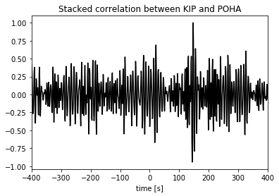
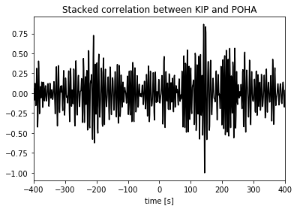
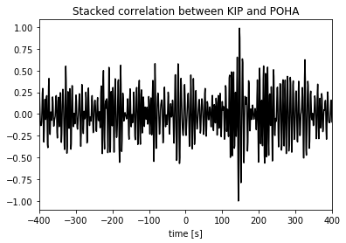
Various Normalization methods and their results
Clipping
1Bit
Clipping_iter

Slide 9
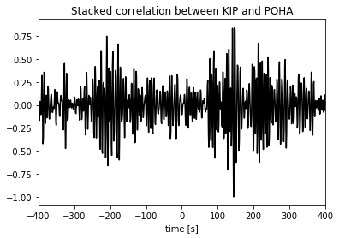
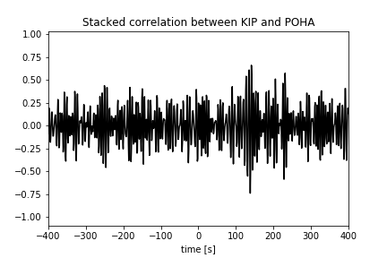
RAMN
A New normalisation method introduced here by me – “Trigger”
Advantages of ‘Trigger’
Better Signal to Noise Ratio (SNR)
More symmetric, i.e provides better normalization
Flexible, i.e user can adjust values according to his needs

Slide 10
“Trigger” algorithm
It detects the earthquake(small or big) using STA/LTA ratio and making the amplitude of next few seconds(usually 45-60s) equal to 1 to neglect the effect of earthquakes.
STA = short term average, LTA = long term average, usually STA = 1-2s and LTA=30-60s depending weather the area is seismically quiet. The threshold value for STA/LTA is kept about 5-10 but higher values can be used for removing regional and teleseismic earthquakes. In this algorithm all the parameters can be set by user until he gets a correlogram with the best snr and symmetric waveform.
I tested for Hawaii, the best threshold values came to be 40, lower threshold values will give more noise,higher threshold values will increase the distortion.

Slide 11
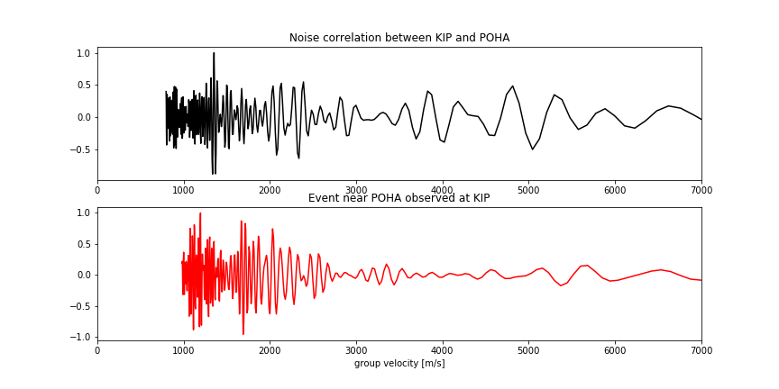
Future Scope
Investigate how the SNR ratio varies with threshold, STA window,LTA window and post event time applying this algorithm to data from various stations around the world.

Slide 12
Recent applications of Seismic Ambient Noise Tomography
Reservoir imagining using Ambient noise correlation from a Dense seismic network
Ambient seismic noise tomography of the southern east sea
Near surface study at the Valhall oil field from ambient noise surface wave tomography
Vs imaging from ambient noise Rayleigh wave tomography for oil exploration in Nevada, USA
Ambient noise tomography for Geothermal exploration case study of WWs geothermal field
Autocorrelation reflectivity of Mars (2020)

Slide 13
References
1) High-Resolution Surface-Wave Tomography from Ambient Seismic Noise
Nikolai M. Shapiro,Michel Campillo,Laurent Stehly, Michael H. Ritzwoller (2005)
DOI: 10.1126/science.1108339
2) G. D. Bensen, M. H. Ritzwoller, M. P. Barmin, A. L. Levshin, F. Lin, M. P. Moschetti, N. M. Shapiro, Y. Yang, Processing seismic ambient noise data to obtain reliable broad-band surface wave dispersion measurements, Geophysical Journal International, Volume 169, Issue 3, June 2007, Pages 1239–1260, https://doi.org/10.1111/j.1365-246X.2007.03374.x
3) Computational seismology – Heiner Igel
Note : source code file for this processing is available on request.
Thank you!

Slide 14


